Slide 1
NLP
(Natural language Processing)
LECTURE 2

Slide 2
Natural Language Tasks
Processing natural language text involves many various syntactic, semantic and pragmatic tasks in addition to other problems.

Slide 3
1) Syntactic Tasks

Slide 4
Word Segmentation
Breaking a string of characters into a sequence of words.
For a language like English, i.e “This is a boy”. since words are usually separated by spaces.
However, some written languages like Chinese, Japanese and Thai words are not separated by spaces., and in those languages text segmentation is a significant task requiring knowledge of the vocabulary and morphology of words in the language.

Slide 5
Word Segmentation
Then white-space can be used to separate words [e.g. , ; . - : ( ) ]
Examples from English URLs:
  jumptheshark.com ⇒ jump the shark .com
  myspace.com/pluckerswingbar
  ⇒ myspace .com pluckers wing bar
  ⇒ myspace .com plucker swing bar
⊗

Slide 6
Morphological Analysis
Morphology is the field of linguistics that studies the internal structure of words. (Wikipedia)
A morpheme (cannot be divided in to smaller meaningful unit) is the smallest meaningful unit of a language (Wikipedia)
e.g. the (article) bird (noun) like (adjective) man (noun)
Morphological analysis is the task of segmenting a word into its morphemes:
  carried ⇒ carry + ed (past tense)
  independently ⇒ in + (depend + ent) + ly
  Googlers ⇒ (Google + er) + s (plural)
  unlockable ⇒ un + (lock + able) ?
  ⇒ (un + lock) + able ?
  Note: Morpheme and Word are two different thing: The principal difference between the two is that a morpheme may or may not stand alone, whereas a word, by definition, is freestanding.

Slide 7
Types of morphology
Inflectional morphology
Derivational morphology (word formation)
Compounding morphology

Slide 8

Inflectional Morphology
Inflectional morphology studies the way in which words vary (or ‘inflect’) in order to express grammatical contrasts in sentences such as singular/plural or past/present tense.
This involves creating different forms of a word, typically expressing grammatical information (e.g. tense etc):
  N _{plural} -> N+s
    Baby -> babies

Slide 9
Note:
Inflectional morphemes: vary (or "inflect") the form of words in order to express grammatical features, such as singular/plural or past/present tense. Thus Boy and boys, for example, are two different forms of the "same" word; the choice between them, singular vs. plural, is a matter of grammar and thus the business of inflectional morphology. (Crystal, p. 90.)

Slide 10
Derivational Morphology
This involves combining a morpheme (add or affix) with a word to create a new word:
  V + er -> N
    [_{N} [_{V} destroy ] +er ]
    [_{N} [_{V} [_{N} [_{V} compute ] +er ] +ize ] +ation ]
creates new words from old ones: the core meaning might change significantly,
i.e (e.g. walk and walker)

Slide 11
Compound Morphology
This involves combining two words to make a third:
  N+N -> N
    [_{N} [ _{N} table ] [_{N} top ]]
    [tabletop] (game)
    footpath…. composed of the two nouns foot and path.

Slide 12
Tagset
Tagset is the set of tags from which the tags is supposed to choose to attach to the relevant word
A commonly used tagset consist of:
  N(Noun),
  V(Verb), i.e Go, strike, travel,
  ADJ(Adjective),i.e. brown dog, fat cat
  ADV(Adverb), i.e. badly, quickly, very
  PREP(Preposition), i.e. above , before, with, to
  CONJ(Conjunction) i.e. and, but,
  INTRJ(Interjection) oh, oops ,great

Slide 13
Part Of Speech (POS) Tagging
The process of marking up the words in a text as corresponding to a particular part of speech is called POS tagging. (or)
The process of assigning one of the parts of speech to the given word is called Parts Of Speech tagging. It is commonly referred to as POS tagging. Parts of speech include nouns, verbs, adverbs, adjectives, pronouns, conjunction and their sub-categories.

Slide 14
Part-Of-Speech Tagging
Example 1:
  Naina cut the apple with a knife.
N → Naina
V → cut
Det → the
N → apple
PREP → with
Det → a
N → knife
Determiners are words placed in front of a noun to make it clear what the noun refers to e.g:The,my,some,this e.t.c

Slide 15
Part-Of-Speech Tagging
Example 2:
  A book was given to Marry by John
Det → a
N → book
V (helping) → was
V → given
PREP → to
N → Marry
PREP → by
N → John

Slide 16
Part-Of-Speech Tagging
Example 3:
  The boy went home.
Det → the
N → boy
V → went
N → home

Slide 17
Part Of Speech (POS) Tagging
Note: That some words can have more than one tag associated with. For example, chair can be noun or verb (Moderate میزبانی کرنا ) depending on the context.

Slide 18
Part-Of-Speech Tagger
A Part-Of-Speech Tagger (POS Tagger) is a piece of software that reads text in some language and assigns parts of speech to each word (and other token), such as noun, verb, adjective, etc.

Slide 19
Syntax analysis
Definition
  In syntax analysis, the exact structure of an input sentence is determined

Slide 20
Syntax analysis
Why use syntax analysis?
  To check whether a sentence is syntactically correct or not, according to the grammar of that language

Slide 21
Syntax analysis: Parsing
How syntax analysis is performed?
  By using Parsing
  Definition 1:
    determining the structure of a piece of language, usually a sentence, according to a grammar of the language

Slide 22
Syntactic Analysis: Parsing
The term parsing comes from Latin pars meaning part (of speech).
  In computer science and linguistics, parsing, or, more formally, syntactic analysis, is the process of analyzing a text, made of a sequence of tokens (for example, words), to determine its grammatical structure with respect to a given formal grammar.
  Parsing is also an earlier term for the diagramming of sentences of natural languages.

Slide 23
Syntactic Analyzer: Parser
A piece of software that analyzes the input sentence syntactically is called parser
Parser maps the words into a structure called parse tree.
Parsing is similar to the process of diagramming sentences
The parser identifies:
  Sentence (S)
  Noun Phrases (NP)
  Verb Phrases (VP)
  Prepositional Phrases (PP)
  Adjectival Phrase (AdjP):

Slide 24
Phrase: Phrase is a group of words that work together to make meaning, but it is not a complete sentence.
Examples of phrases:
the brown hat
blowing away
in the wind

Slide 25
Noun Phrases (NP): A nouns phrase consists of a noun and all its modifiers.
A modifier is to modify (change the meaning of) another element.
This is a red ball, the adjective red is a modifier, modifying the noun ball.
Examples of noun phrases:
the brown hat
my English teacher

Slide 26
Verb Phrases (VP): A Verb phrase consists of a verb and all its modifiers.
Examples of verb phrases:
ran quickly

Slide 27
Prepositional Phrases (PP): A prepositional phrases begin with a preposition and can acts as noun, an adjective or an adverb.
Examples of prepositional phrases:
on the boat
above the stove
around the corner

Slide 28
Adjectival Phrase (AdjP): An adjective phrase is a group words that describe a noun or pronoun in a sentences.
Examples of Adjectival phrases:
My brother is older than me.
This stone is the heaviest of all.
I feel sorry for people living on the streets.

Slide 29
Determiners and articles
Determiners are words placed in front of a noun to make it clear what the noun refers to e.g:The,my,some,this e.t.c

Slide 30
Syntactic Analyzer: Parser
  Sentence (S)
  S→NP VP

Slide 31
Syntactic Analyzer: Parser
  Noun Phrases (NP)
  NP→N
    [John] sleeps
  NP→PRON
    [He] sleeps
  NP→Det N
    [A student] sleeps
  NP→NP PP
    [A student in the back] sleeps
  NP→Det Adj N
    [A tall student] sleep

Slide 32
Syntactic Analyzer: Parser
Verb Phrase (VP):
  VP→V
    She [eats]
  VP→V N
    She [eats mango]
  VP→V NP
    She [eats an apple]
  VP→V N PP
    She [gives apple in plate]
  VP→V PP
    She [eats with spoon]

Slide 33
Syntactic Analyzer: Parser
Prepositional Phrase (PP):
  PP→PREP N
    On table
  PP→PREP NP
    On the table
Adjectival Phrase (AdjP):
  AdjP→Adj
    big
  AdjP→Adv AdjP
    Very big

Slide 34
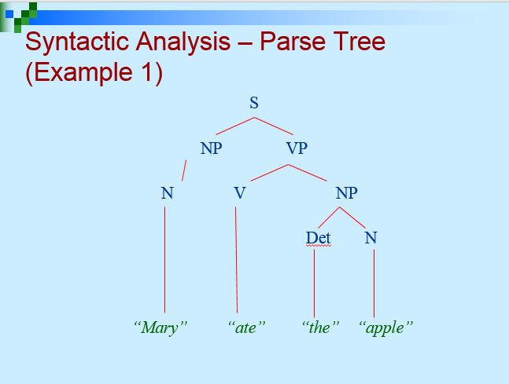

Slide 35
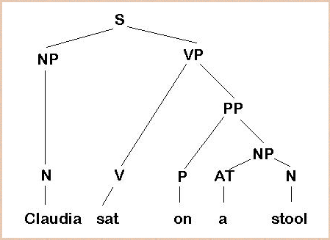
Syntactic Analysis – Parse Tree (Example 2)

Slide 36
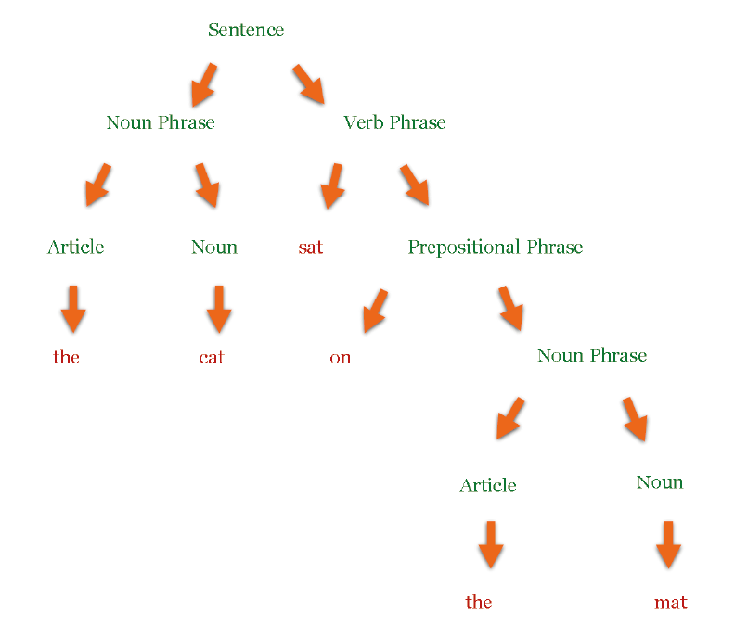
Syntactic Analysis – Parse Tree (Example 3)
The cat sat on the mat.

Slide 37
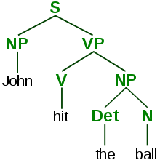
Syntactic Analysis – Parse Tree (Example 4)
John hit the ball.

Slide 38
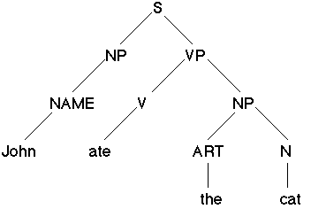
Syntactic Analysis – Parse Tree (Example 5)
John ate the cat.

Slide 39
Types of Parsing
Two types:
  Top-down
  Bottom up

Slide 40
Top-down Parsing
A top-down parser searches for a parse tree by trying to build from the root node to the leaves.
Start at the root node, expand tree by matching the left-hand side of rules
For example see figure 1.1

Slide 41
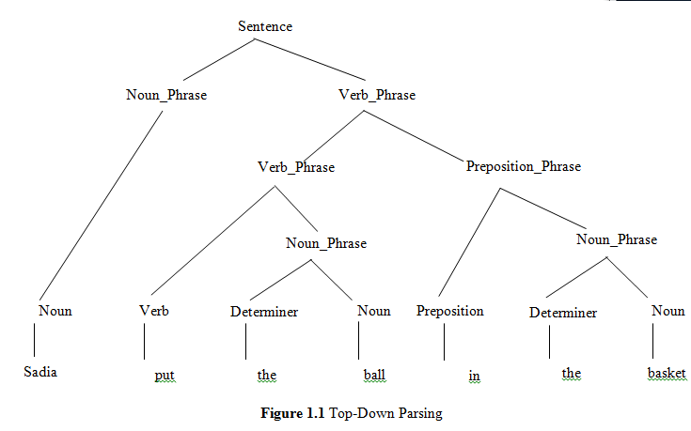

Slide 42
Bottom-up Parsing
In bottom-up parsing, a sentence is analyzed from left to right, determine all possible syntactic structures
A bottom-up parser builds a parse tree from its leaves to root node
Start with the leaves, build tree by matching the right-hand side of rules
The bottom-up parsing for the sentence “Sadia put the ball in the basket” is given in figure 1.2

Slide 43
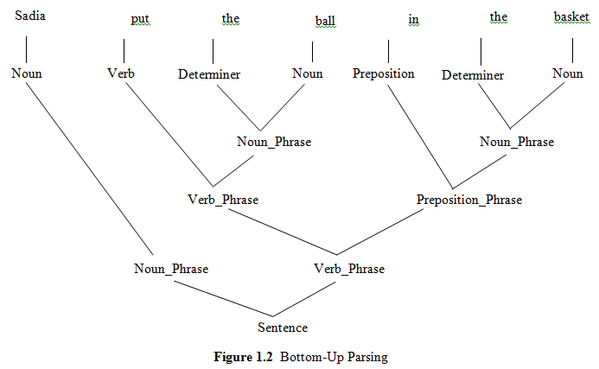
Bottom-up Parsing (Cont..)

Slide 44
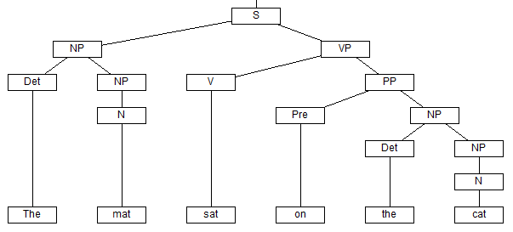
Note:
The mat sat on the cat.
    (Syntactically correct but semantically incorrect)

Slide 45
Why is parsing important?
Breaking a data block into smaller chunks by following a set of rules, so that it can be more easily interpreted, managed, or transmitted by a computer.
In linguistics, to divide language into small components that can be easily analyzed. For example, parsing the sentence would involve dividing it into words and phrases and identifying the type of each component (e.g.,verb, adjective, or noun).

Slide 46
Phrase Chunking
Phrase chunking is a natural language process that separates and segments a sentence into its sub constituents or parts, such as noun phrases, verb pharses, and prepositional phrases.
Example: I ate the spaghetti with meatballs.
[NP I] [VP ate] [NP the spaghetti] [PP with] [NP meatballs].

Slide 47
The End
Life is 10% of what you face, and 90%
of how you respond to it
________________
Thank You
God Bless You

Slide 48
End Syntactic Tasks

